Slide 1


André Roussel
April 2nd, 2025

Slide 2

Outline
Executive Summary
Introduction
Methodology
Results
Conclusion
Appendix

Slide 3
Executive Summary
The goal of this project is to predict the success of Space X Falcon 9 first-stage landings to build a business case for reusable first-stage rockets. According to available data, he ability to reuse the first-stage reduces the price of a lauch from roughly $165 millions dollars to around $62 million dollars which is a substantial savings.
The approach is:
Collect data from publicly available databases and websites
Explore and wrangle data to analyze and summarize datasets to understand their main characteristics and uncover patterns.
Build and compare machine learning modules to predict the success of first-stage landings
The tools used are Python, Dash, Folium, SQL, Scikit-learn and multiple other data science libraries
From multiple models, the decision tree shows the most promise with a prediction accuracy on the testing data of 88% (the decision tree parameters where adjusted due to an issue with the auto criterion in max_features parameter).

Slide 4
Introduction
Background
SpaceX launches are significantly cheaper due to reusability.
Predicting landing success helps understand launch economics.
Project explores this using real launch data from various sources.
Problem Statement
• Can we accurately predict whether a Falcon 9 first-stage will land successfully?
• Binary classification problem: 0 = Failure, 1 = Success.
• Focus on identifying key features affecting landing outcome.

Slide 5

Section 1

Slide 6
Methodology
Executive Summary
Data collection methodology:
Data collection was done using APIs and Web Scraping
Perform data wrangling
Data was explored to identify missing values, identify characteristics of the data, etc…
Perform exploratory data analysis (EDA) using visualization and SQL
Perform interactive visual analytics using Folium and Plotly Dash
Perform predictive analysis using classification models
After the data was cleaned and understood (characteristics), it was standardized, split into training and testing sets, and used to build and compare Logistic Regression, Support Vector Machine (SVM), Classification tree and K nearest neighbor (KNN) models.

Slide 7
Data Collection
Data Sources Overview
SpaceX REST API – launch data.
Wikipedia – rocket details and historical launches.
External JSON/CSV datasets.
Data integrated and cleaned into a unified pandas DataFrame for modeling.

Slide 8
Data Collection – SpaceX API
Request
Request and parse initial launch data
Decode
Decode and format as a Pandas data frame
Explore data
Initial data table is ID based
Complete data based on IDs
Request based on rocket, payload, launchpad, etc..
Complete DataSet
Complete the data set using helper functions
Collected historical launch data using SpaceX REST API.
Data includes launch site, payload mass, orbit, and landing outcome.
Sample API response parsed from JSON to DataFrame.
Challenges: handling inconsistent or missing fields.
Code available at (may have to download it to visualize it) https://github.com/Andre-Roussel/IBM-Skills-Build-DataScience-Capstone/blob/6fb62b72c62eeebb5b8f185cafbf17010d40c84f/jupyter-labs-spacex-data-collection-api-v2.ipynb

Slide 9
Data Collection - Scraping
Request
Request falcon 9 Wikipedia page
Parse
Parse response using Beautiful soup
Extract
Extract tables from data
Get headers for DataFrame
Iterate through TH to get data headers and create data frame
Get Data
Iterate through table rows and get data to complete dataframe
Supplemented API data with Wikipedia scraping for rocket specs.
Used BeautifulSoup to extract tabular data on Falcon 9 launches.
Data merged and deduplicated based on flight number and date.
Code available at (may need to be downloaded): https://github.com/Andre-Roussel/IBM-Skills-Build-DataScience-Capstone/blob/6fb62b72c62eeebb5b8f185cafbf17010d40c84f/jupyter-labs-webscraping.ipynb

Slide 10
Data Wrangling
Merged datasets from API and web sources.
Dropped nulls and redundant columns.
Created new features: booster version, landing pad, etc.
Filtered for Falcon 9 missions only.

Slide 11
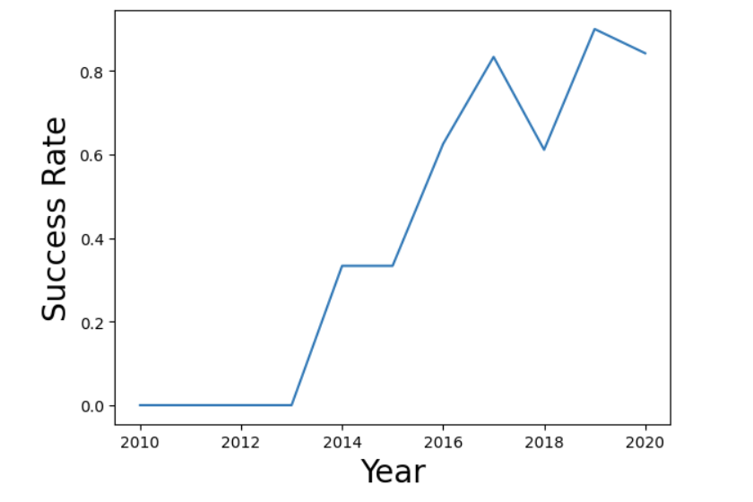
EDA with Data Visualization
Used Seaborn and Matplotlib for visual analysis.
Key charts: payload vs. success, launch site success rate, orbit type trends.
Detected correlations and candidate features for modeling.
Code available at (may need to be downloaded): https://github.com/Andre-Roussel/IBM-Skills-Build-DataScience-Capstone/blob/main/jupyter-labs-eda-dataviz-v2.ipynb

Slide 12
EDA with SQL
Queried launch site names, payload distributions, and mission outcomes.
Example: total payload mass from NASA launches.
%sql select sum(PAYLOAD_MASS__KG_) as Total_Payload_Mass from SPACEXTABLE where Customer = 'NASA (CRS)'
Used SQLite to interact with structured dataset and confirm patterns.
Code available at (may need to be downloaded): https://github.com/Andre-Roussel/IBM-Skills-Build-DataScience-Capstone/blob/main/jupyter-labs-eda-sql-coursera_sqllite.ipynb

Slide 13
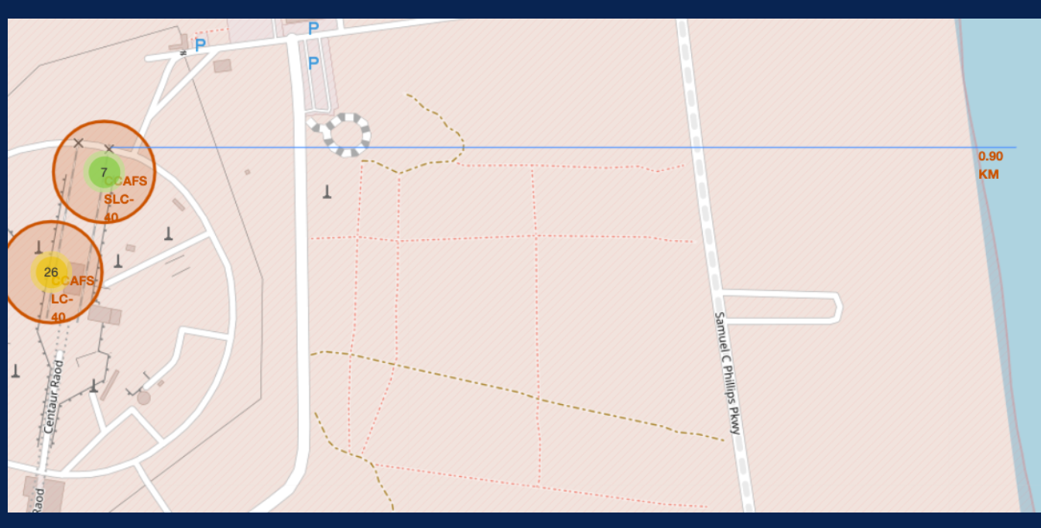
Build an Interactive Map with Folium
Mapped launch sites using Folium.
Markers show site names, success/failure, and coordinates.
Used Circle and PolyLine to highlight proximity to coastlines, highways.
Code available at (may need to be downloaded): https://github.com/Andre-Roussel/IBM-Skills-Build-DataScience-Capstone/blob/main/lab-jupyter-launch-site-location-v2.ipynb

Slide 14
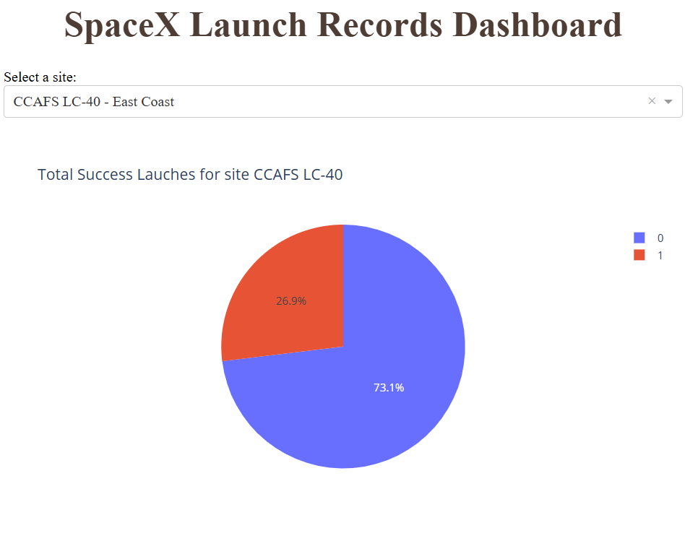
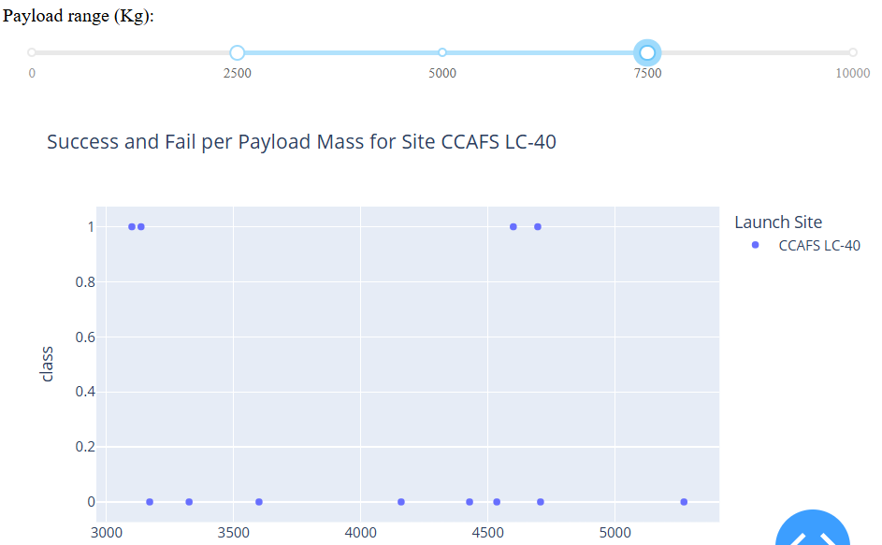
Build a Dashboard with Plotly Dash
Pie chart shows success count per site or for all sites combined.
Highlights which sites have higher reliability.
Scatter plot visualizes relationship between payload mass and landing outcome.
Interactive payload slider allows dynamic filtering.
Insights: mid-range payloads often show higher success.
Code available at (may need to be downloaded):
https://github.com/Andre-Roussel/IBM-Skills-Build-DataScience-Capstone/blob/main/spacex_dash_app.py
Note: This was coded to run on my RaspberryPi at home which was actually kinda fun…

Slide 15
Predictive Analysis (Classification)
Overview
Objective: classify if a launch will be successful.
Features: payload, orbit, booster version, launch site, etc.
Target: landing success (1) or failure (0).
Models tested: Logistic Regression, Decision Tree, SVM, KNN
Model building and Preprocessing
Preprocessing steps: encoding categorical variables, feature scaling.
Train-test split: 80/20 ratio with stratification to preserve class balance.
StandardScaler used for numerical features like payload mass.
OneHotEncoder used for orbit, launch site, and booster version.
Model Evaluation Metrics
Used Accuracy, Precision, Recall, and F1-Score.
Confusion Matrix used to analyze false positives and false negatives.
Cross-validation applied to improve reliability of scores.
Code available at (may need to be downloaded):
https://github.com/Andre-Roussel/IBM-Skills-Build-DataScience-Capstone/blob/main/SpaceX-Machine-Learning-Prediction-Part-5-v1.ipynb
Load Data
Data was prepared in previous stages
Extract and normalize data
Split X,Y data
Split data into training and testing datasets
Create Model Object
Set parameters
Fit Data
Fit training data
Extract Y data and X data. Normalize X data (standard Scaler)
Create Model Object
Verify best parameters
Verify training data accuracy
Verify test data accuracy
Repeat from Create Model Object for other data models

Slide 16
Results
The next section, the following topics are going to be explored
Exploratory data analysis results
Interactive analytics demo in screenshots
Predictive analysis results

Slide 17

Section 2

Slide 18
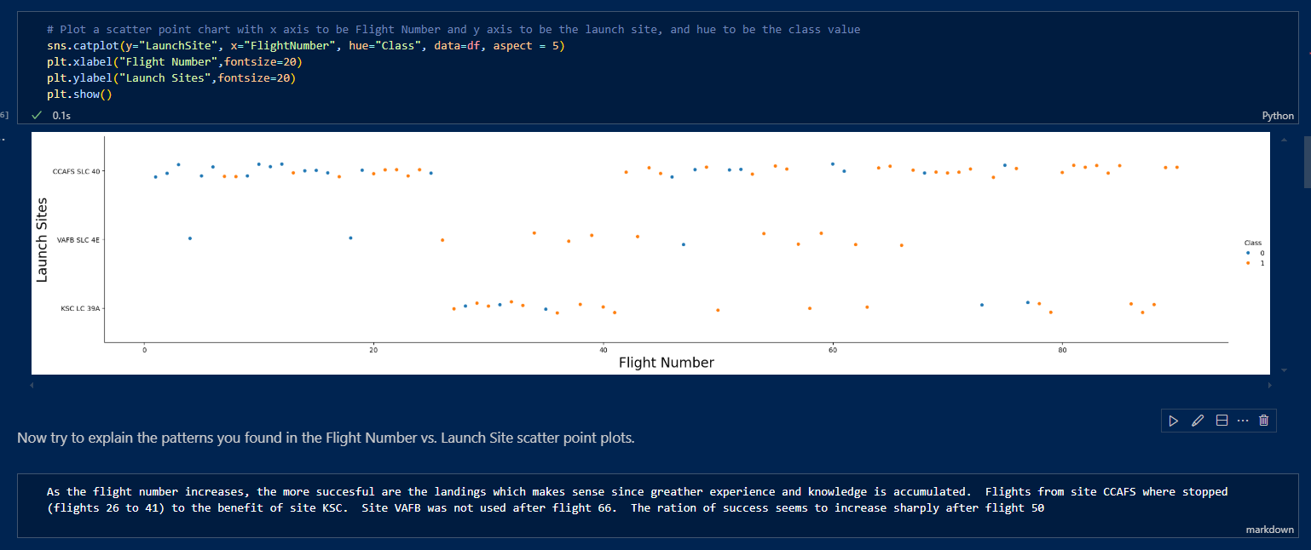
Flight Number vs. Launch Site

Slide 19
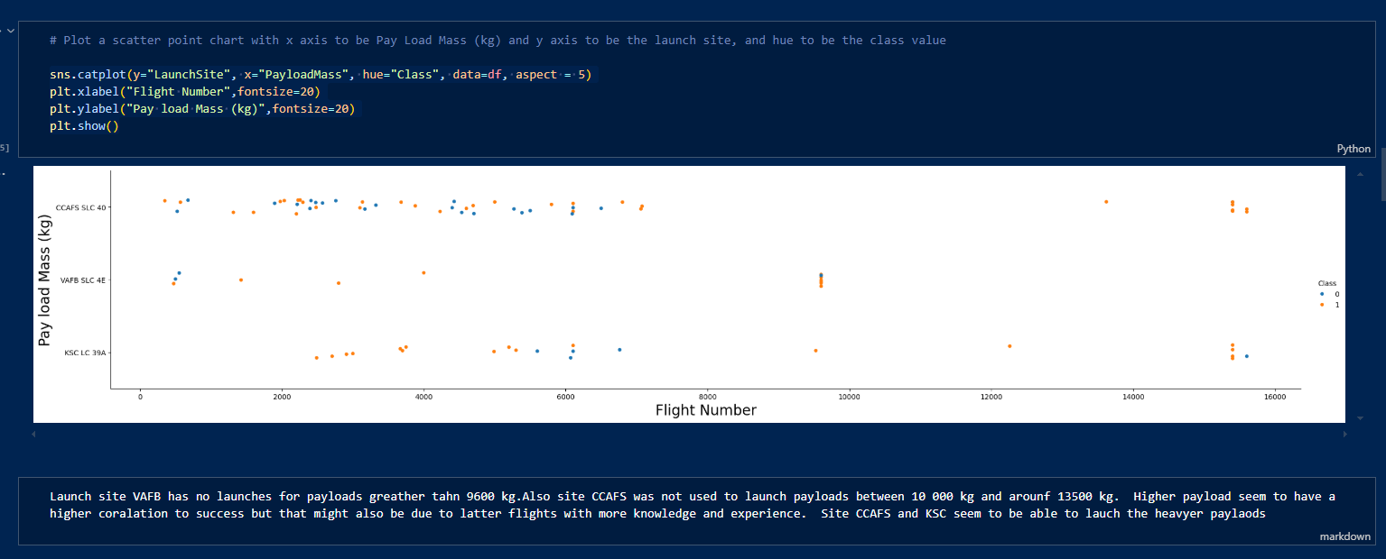
Payload vs. Launch Site

Slide 20
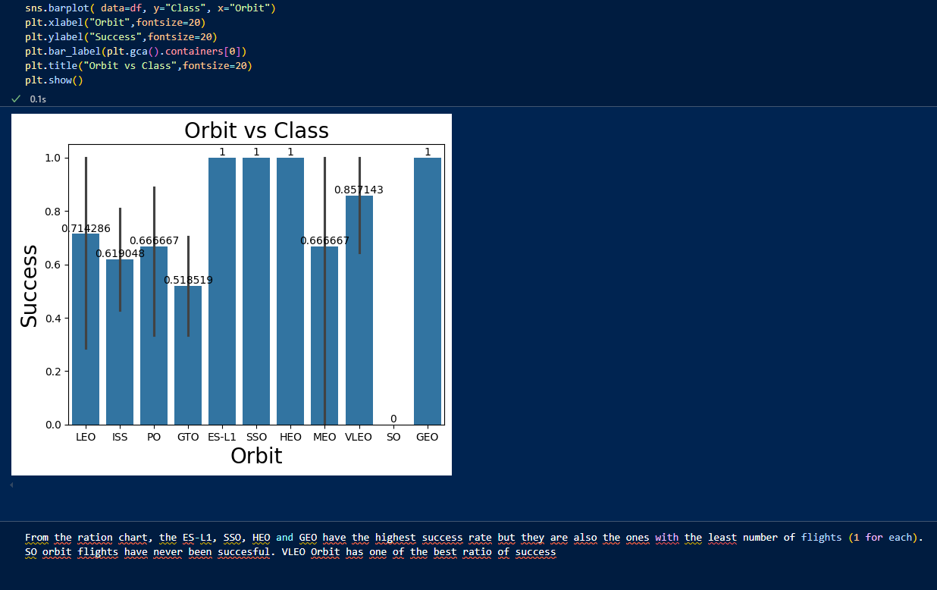
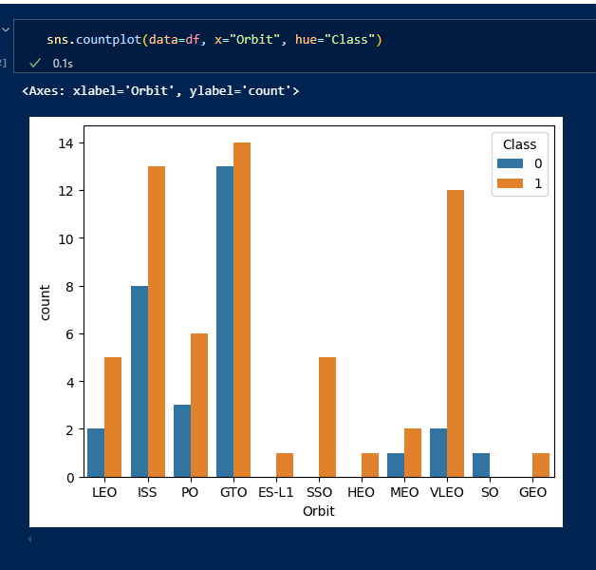
Success Rate vs. Orbit Type

Slide 21
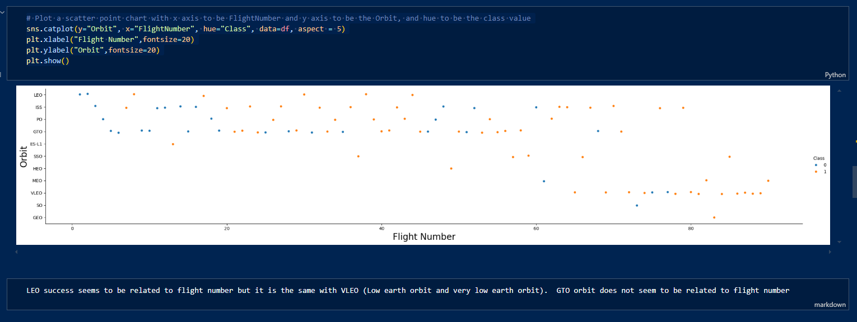
Flight Number vs. Orbit Type

Slide 22
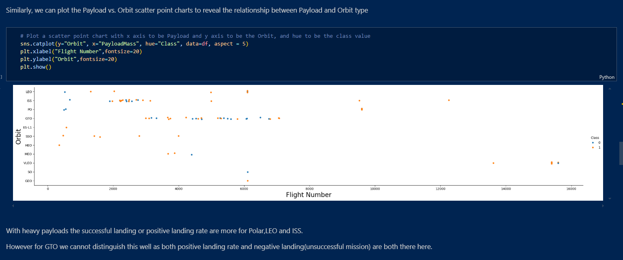
Payload vs. Orbit Type

Slide 23
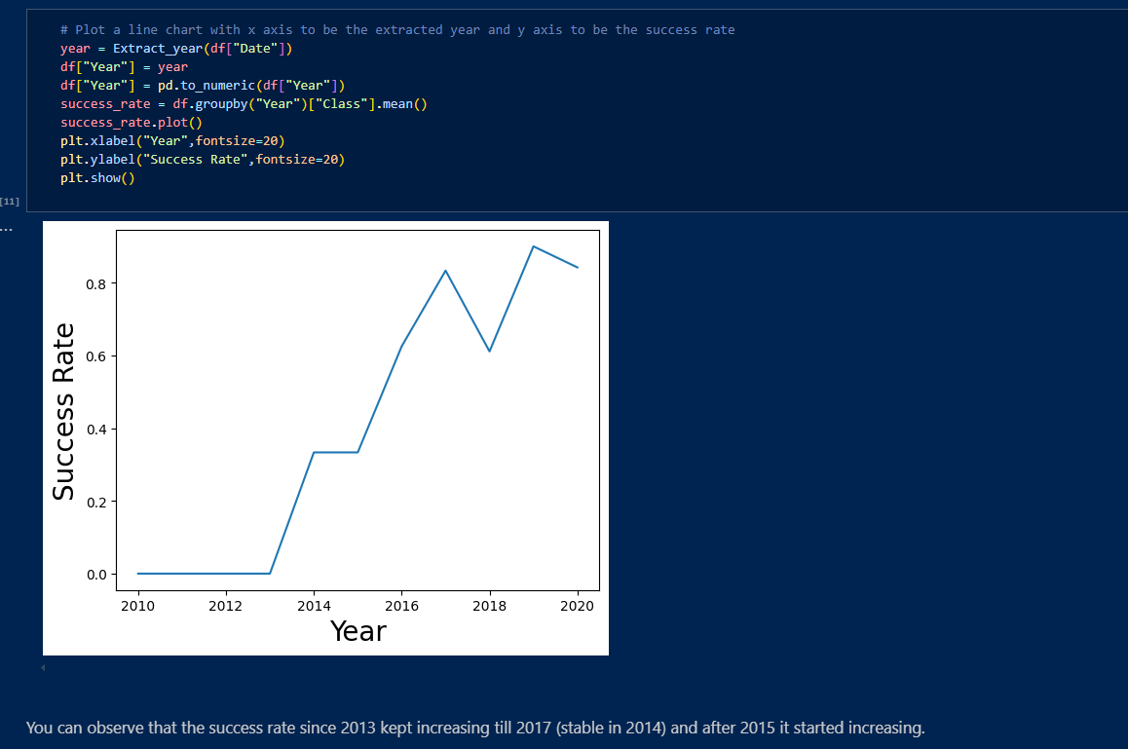
Launch Success Yearly Trend

Slide 24
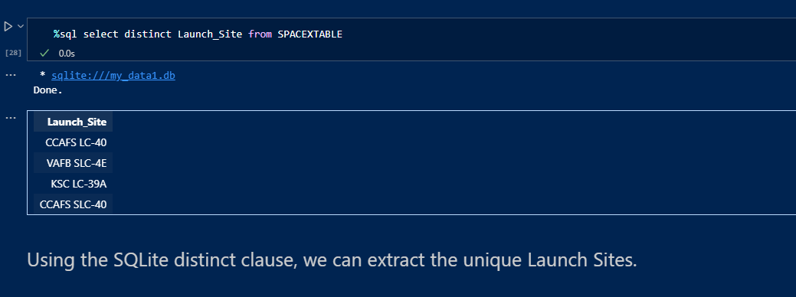
All Launch Site Names

Slide 25
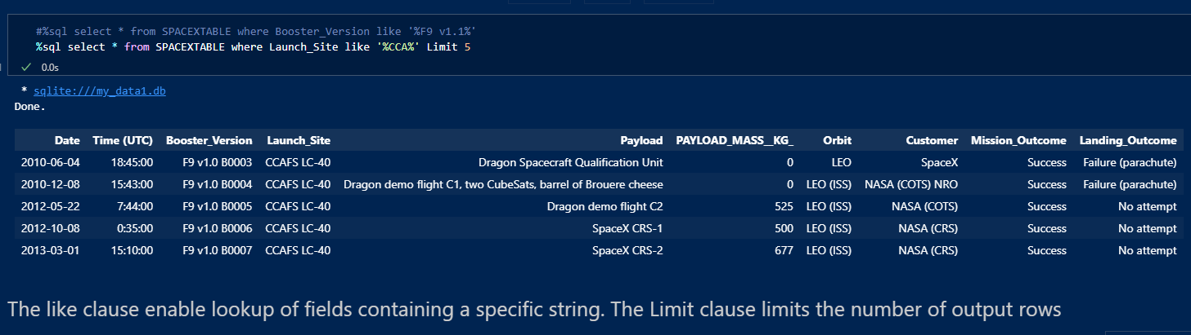
Launch Site Names Begin with 'CCA'

Slide 26
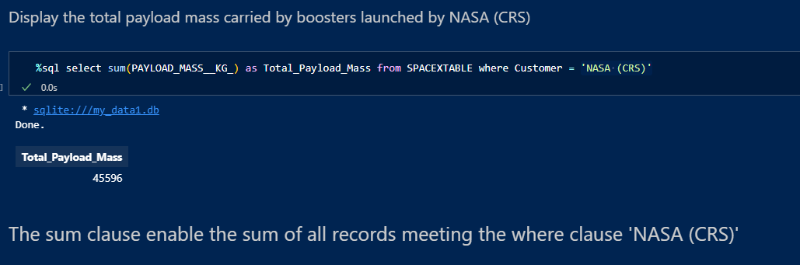
Total Payload Mass

Slide 27
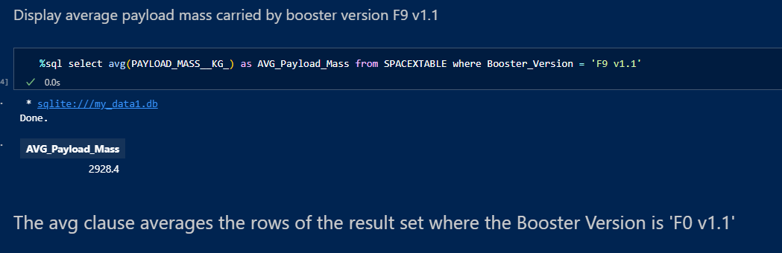
Average Payload Mass by F9 v1.1

Slide 28
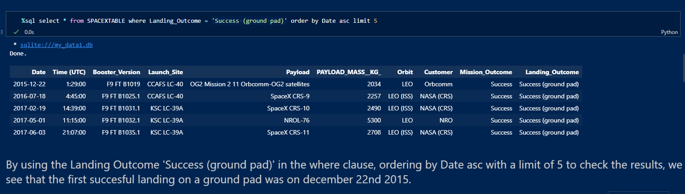
First Successful Ground Landing Date

Slide 29
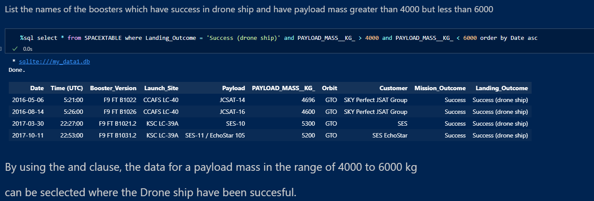
Successful Drone Ship Landing with Payload between 4000 and 6000

Slide 30
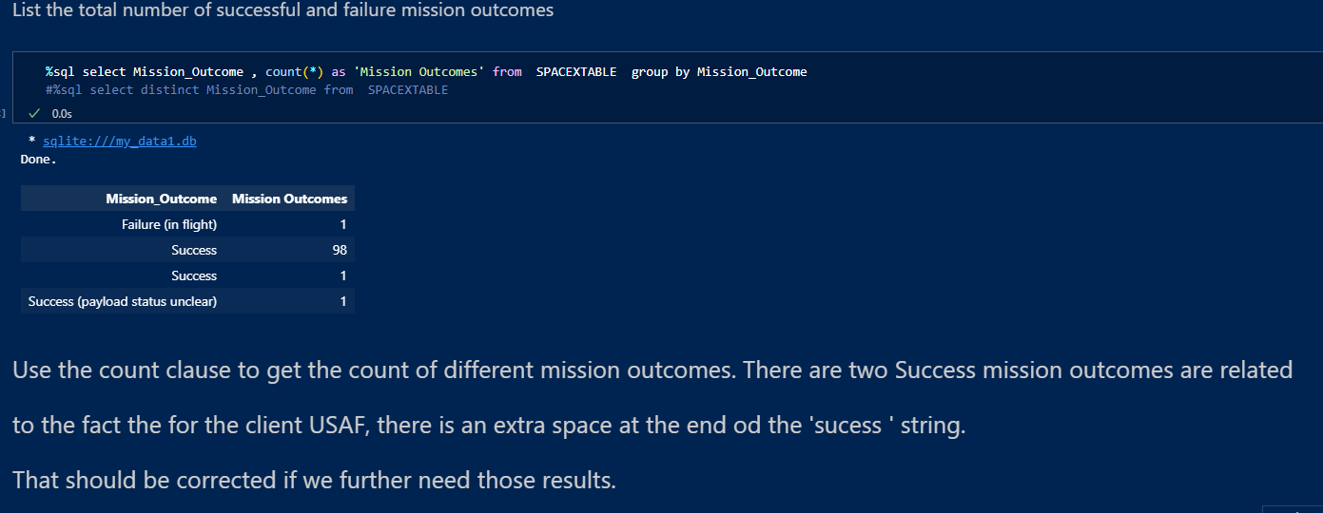
Total Number of Successful and Failure Mission Outcomes

Slide 31
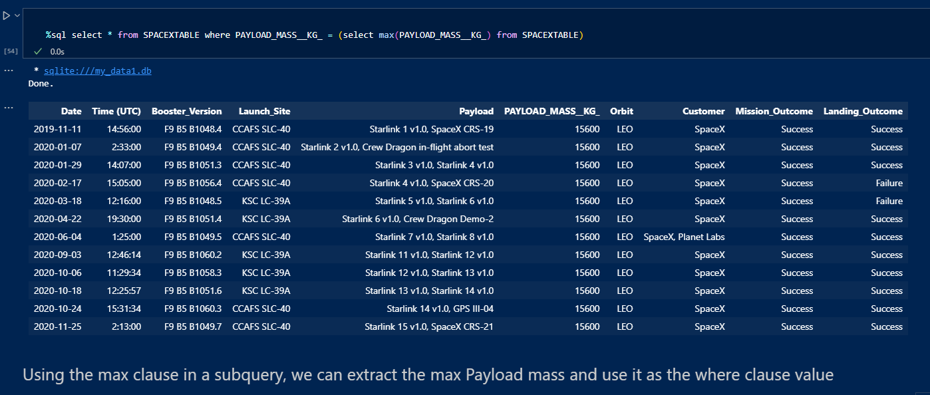
Boosters Carried Maximum Payload

Slide 32
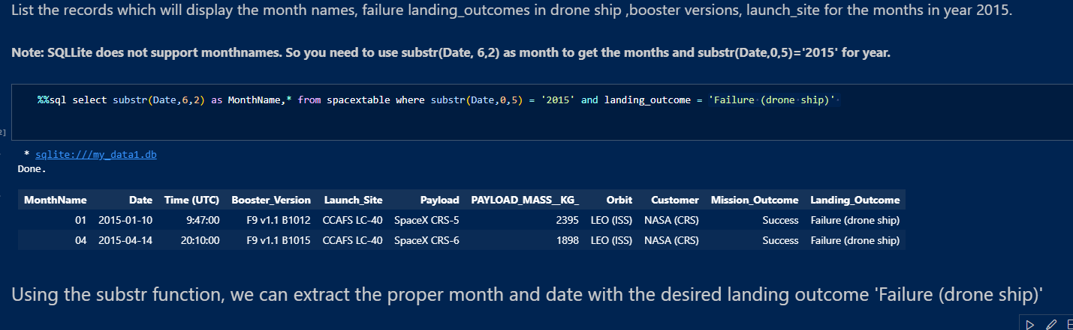
2015 Launch Records

Slide 33
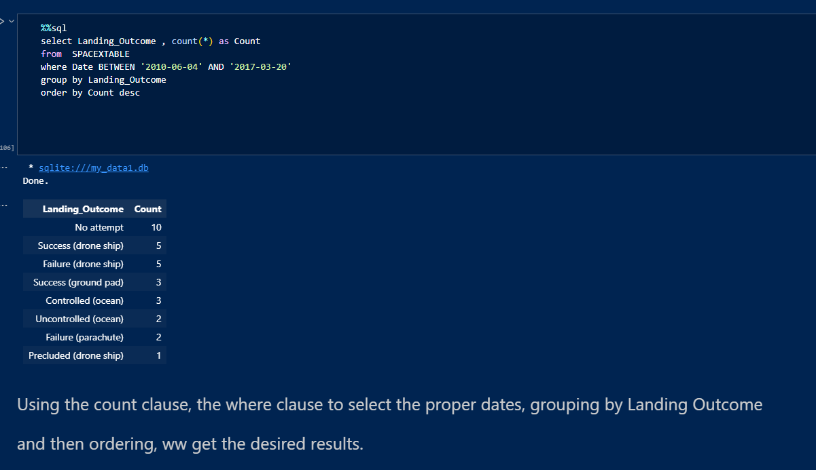
Rank Landing Outcomes Between 2010-06-04 and 2017-03-20

Slide 34

Section 3

Slide 35
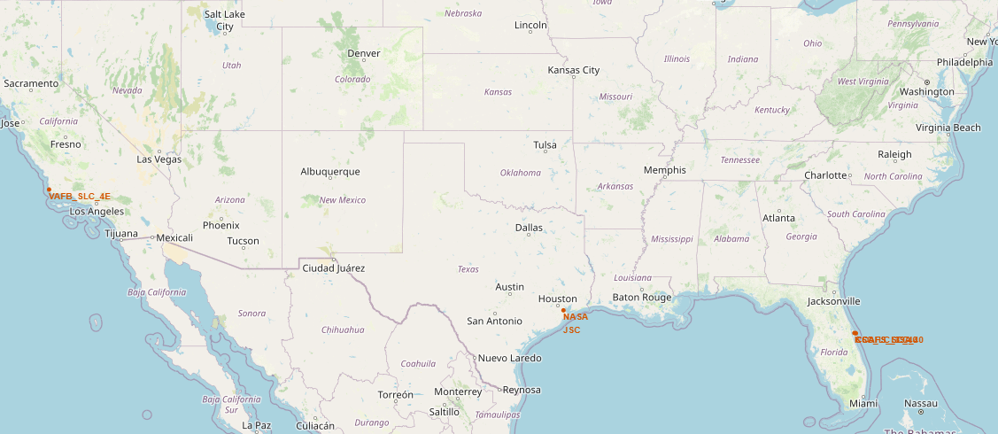
Map of Launch Sites including Huston NASA site
The first thing that we notice is that the launch sites are are as south as possible in the US, very flat areas, close to the sea and with low population and traffic.

Slide 36
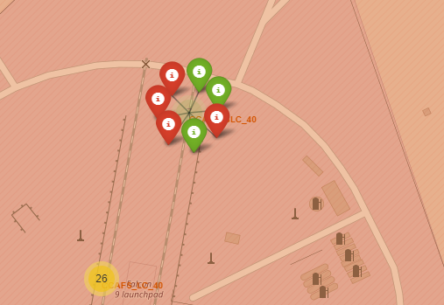
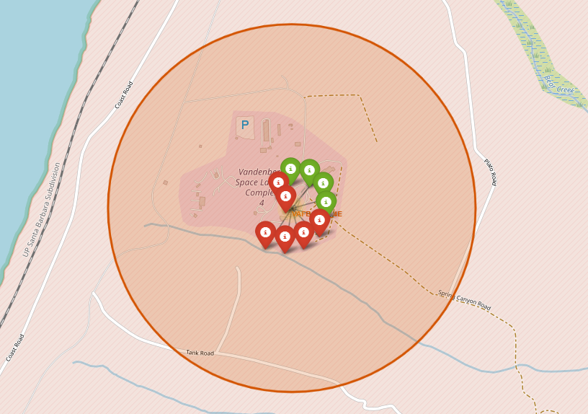
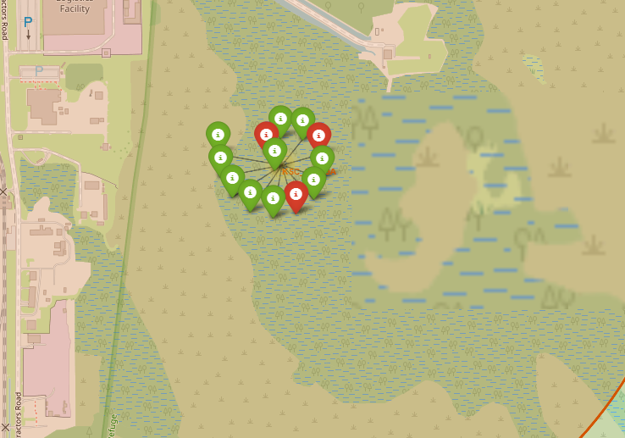
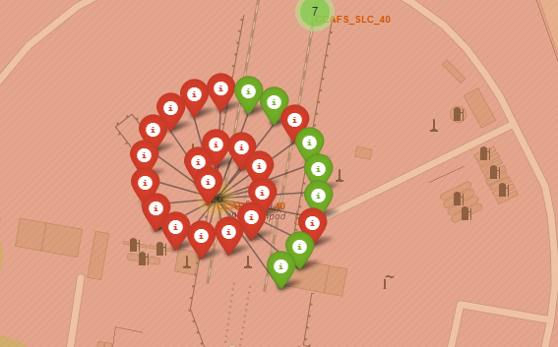
Color coded launch outcomes of all 4 sites.
Cap Canaveral Sites
Vandenberg Site
The most used site it Cap Canaveral. It also has the most successful launch outcomes

Slide 37
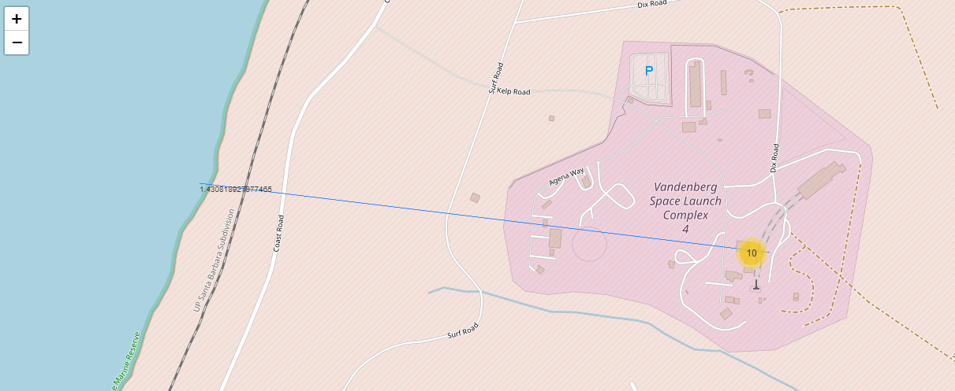
Distance from Vandenberg Launch Site to Sea
Can be used to calculate distance to point of interest for informational, environmental or safety pruposes.

Slide 38

Section 4

Slide 39
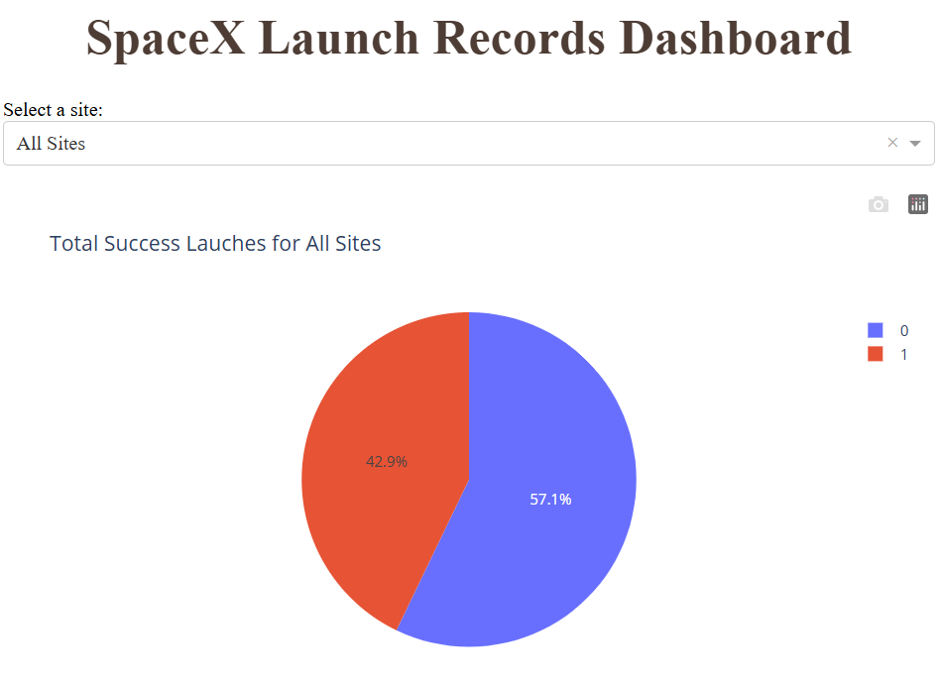
Succes and Failure for All Sites
The conclusion from this is that it is a very expensive undertaking as only 57.1% of the outcomes are succesful

Slide 40
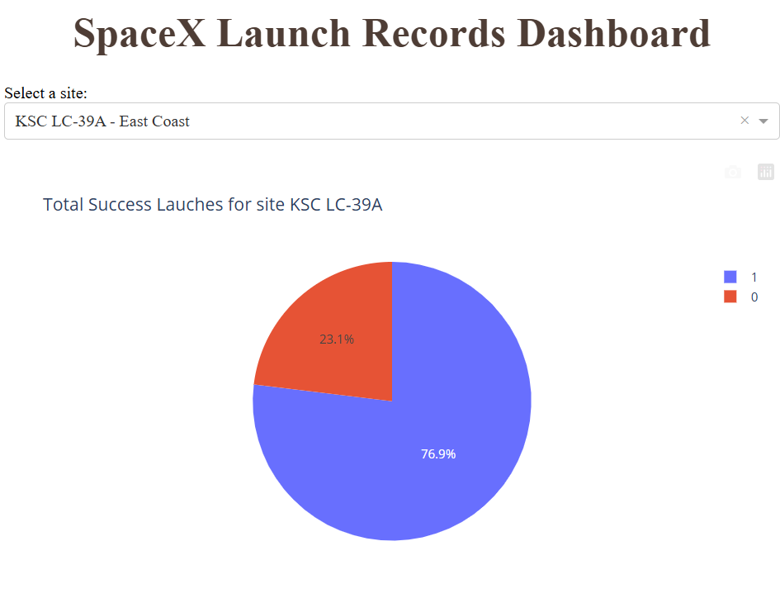
Site with the best outcome
The launch site with the best outcome is KSC LC-39A.

Slide 41
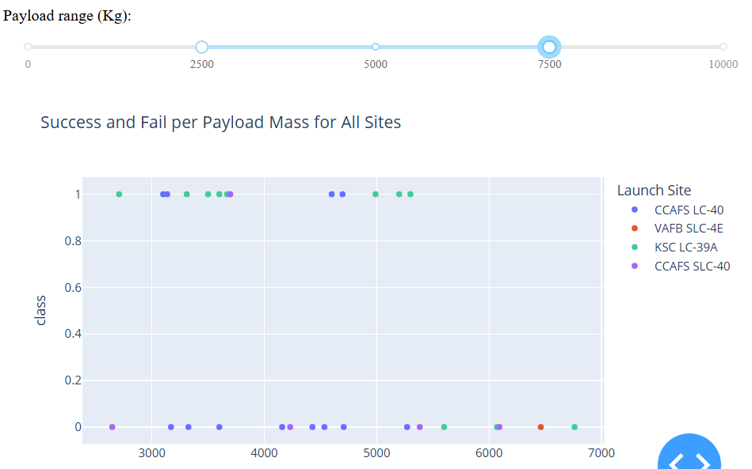
Outcomes for all site for selected payload.
Outcomes for all sites for Payloads between 2500 and 7500 kg. Not very successful is it?

Slide 42

Section 5

Slide 43
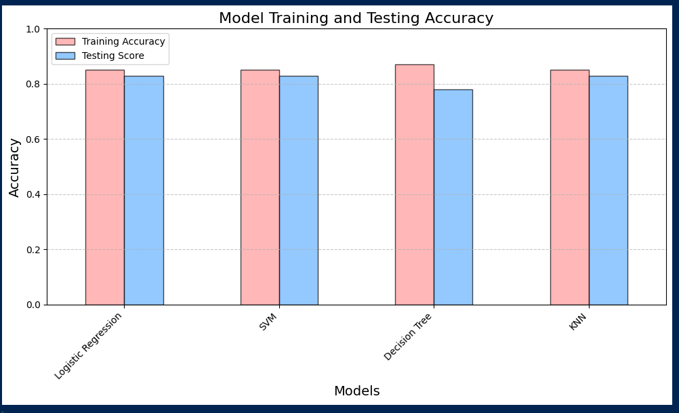
Classification Accuracy
The decision tree with the Log2, sqrt and none has the highest training accuracy but the lowest score on the test data. All other models have the same score for the test data.

Slide 44
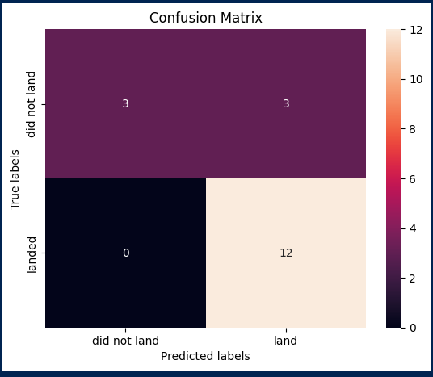
Confusion Matrix
The Logistic Regression, SVM and KNN models essentially perform all the same on the testing data by correctly predicting the non successful launches and by mis predicting 3 successful landing when the where actually no successful.

Slide 45
Conclusions
Overall Project Results
Achieved 83% score on testing data for LogReg, SVM and KNN model and only 77% on Tree classifier model.
Identified payload mass and site as top predictors.
Interactive dashboards and geospatial analysis enriched insights.
Business Implications
Predictive models help forecast cost and risk.
Can be used by competitors or partners to benchmark performance.
Supports data-driven decision-making in aerospace logistics.
Business Implications
Predictive models help forecast cost and risk.
Can be used by competitors or partners to benchmark performance.
Supports data-driven decision-making in aerospace logistics.
Recommendations
Incorporate live API data for real-time prediction updates.
Expand dataset with additional providers for broader comparison.
Deploy the model in a monitoring dashboard for internal use.

Slide 46
Appendix
All notebooks are available at https://github.com/Andre-Roussel/IBM-Skills-Build-DataScience-Capstone

Slide 47


